Slide 1
Project Tracker
Derya Yeliz COŞAR SOĞUKKUYU

Slide 2
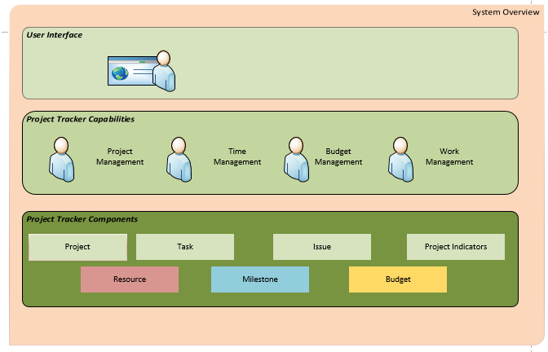
System Overview

Slide 3
System Overview
Project Tracker aims to assist a project manager in developing a plan, assigning resources to tasks, tracking progress, managing the budget, and analyzing workloads.

Slide 4
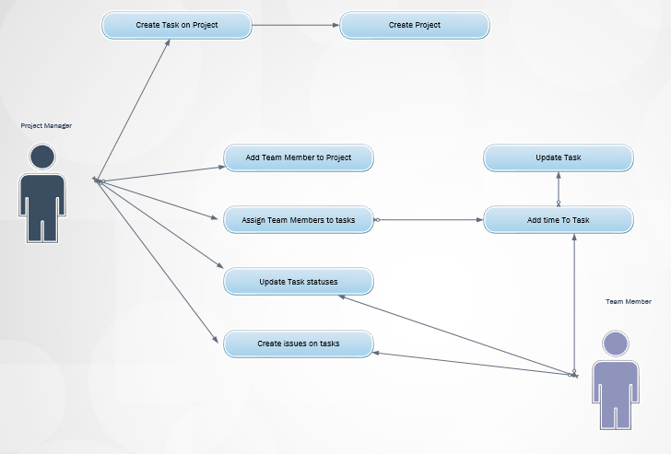
System Overview

Slide 5
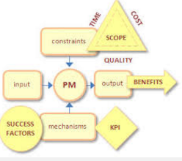
Business Rules
Role | Responsibility
database administrator | Responsible for monitoring performance and managing parameters to provide fast responses to front-end users
Portfolio Managers (View,Edit) | Users can create and edit all project data saved in PT
Project managers (View, Edit) | Users have most global and category-level project permissions and resource permissions for their projects
Team Members (View) | Users have general permissions for using PT, but limited project-level permissions

Slide 6
Business Rules
Project
Project indicators must be green, when there is 10% diffrence between project planned finish date and actual finish date
Resource
Resource allocation shuldn’t be done when resource capacity is full
Resource assignment can only be done by Project Manager
Task
Task Begin date can’t be greater than task ending date
System must alert PM before 3 days on task ending date
Project indicators must be yellow, when there is 10% -20%diffrence between project planned finish date and actual finish date
Project indicators must be yellow, when there is more than 20% diffrence between project planned finish date and actual finish date
Resource capacity is 8 hours max for a day
Resource is assigned to Project Team
Issues are assigned to tasks with resource
Every project has unique budget
Every project has a project manager and a project team

Slide 7
E-R Diagrams

Slide 8
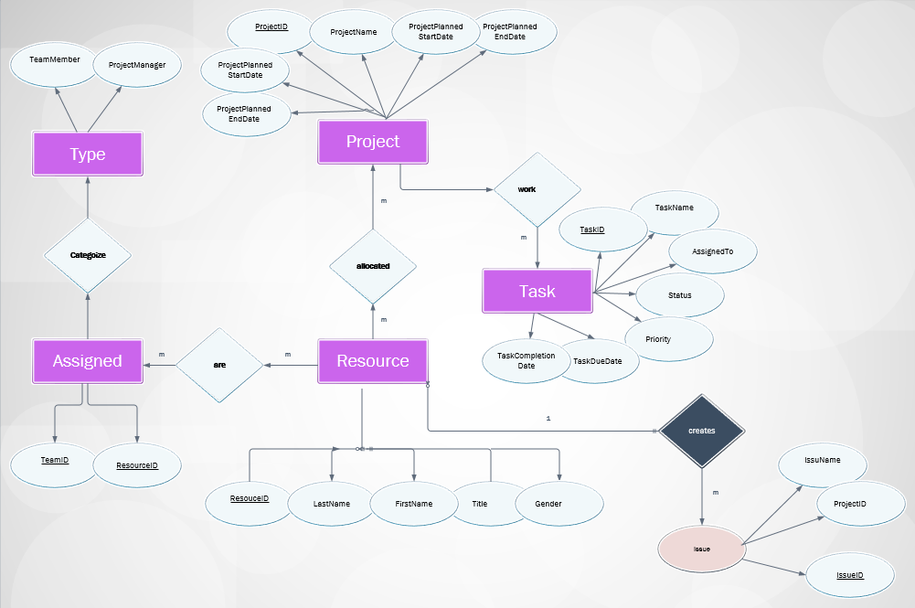
E-R Diagrams

Slide 9
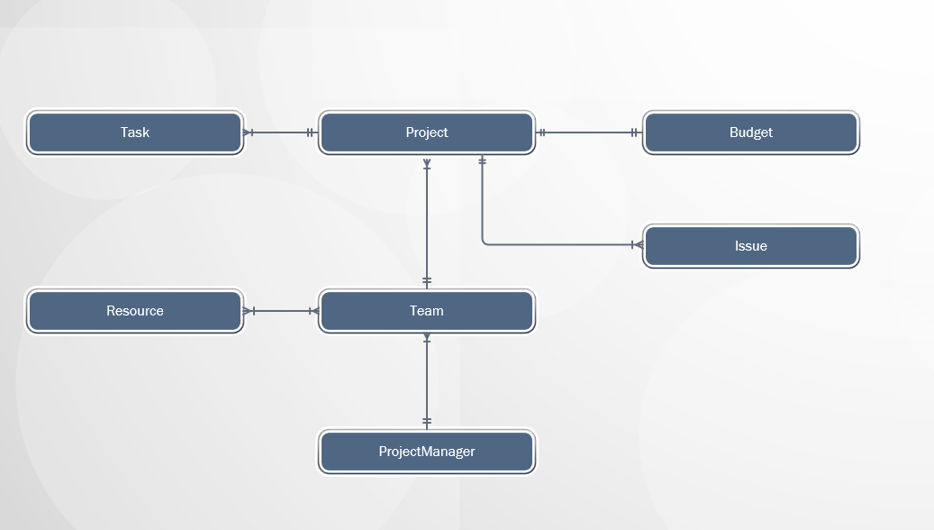
DB Design: Enterprise Data Model

Slide 10
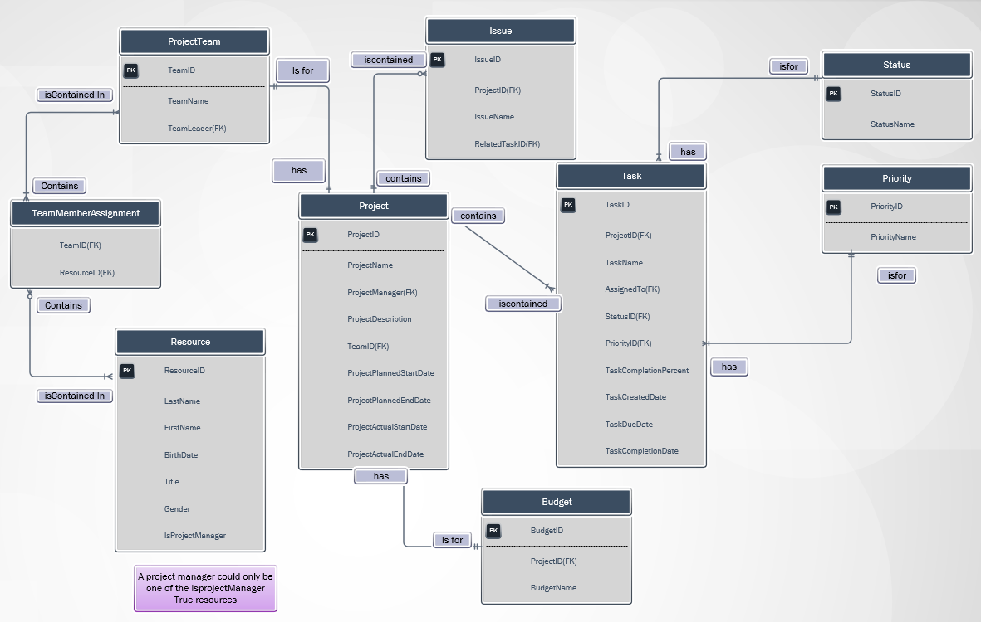
DB Design: Project Data Model

Slide 11
DB Design: Entity Types and Instances
Entity Type : PROJECT
Attributes | Attribute Data Type | Example Instance
ProjectID | INT | 1
ProjectName | NVARCHAR(250) | Project Tracker
ProjectManager | INT | 1
TeamID | INT | 1
ProjectPlannedStartDate | DATE | 01.02.2016
ProjectPlannedEndDate | DATE | 01.06.2016
ProjectActualStartDate | DATE | 30.02.2016
ProjectActualEndDate | DATE | NULL

Slide 12
DB Design: Entity Types and Instances
Entity Type : RESOURCE
Attributes | Attribute Data Type | Example Instance
ResourceID | INT | 1
LastName | NVARCHAR(250) | Coşar
FirstName | NVARCHAR(250) | Yeliz
BirthDate | DATE | 01.02.1985
Title | NVARCHAR(250) | Software Engineer
Gender | NVARCHAR(1) | F
IsProjectManager | BIT | 1

Slide 13
DB Design: Entity Types and Instances
Entity Type : TASK
Attributes | Attribute Data Type | Example Instance
TaskID | INT | 1
ProjectID | INT | 1
TaskName | NVARCHAR(250) | Database Design
AssignedTo | INT | 1
StatusID | INT | 4
PriorityID | INT | 1
TaskCompletionPercent | INT | 100%
TaskCreatedDate | DATE | 01.012016
TaskDueDate | DATE | 30.02.2016
TaskCompletionDate | DATE | 25.02.2016

Slide 14
DB Design: Entity Types and Instances
Entity Type : ISSUE
Attributes | Attribute Data Type | Example Instance
IssueID | INT | 1
ProjectID | INT | 1
IssueName | NVARCHAR(250) | Database Design problems
Status | NVARCHAR(10) | Open
RelatedTaskID | INT | 1
Entity Type : PROJECTTEAM
Attributes | Attribute Data Type | Example Instance
TeamID | INT | 1
TeamName | NVARCHAR(250) | Project Tracker Team
Team Leader | INT | 1

