Slide 1
TAYFUN ÇELİK
Konu: Şehirler Arası Otobüs Terminali

Slide 2
BUSINESS RULES

Slide 3
Person
Person has 3 type of person_type P:passanger ,S: seller ,D :driver
person has property as name ,surname ,sex ,phone_number
seller might sell the ticket from internet or reception desk .If seller sells the ticket from web
Seller type should be ONLINE else it should be LOCAL seller type.
Every seller has a agency name.
If person is sellers , he sells ticket online tickets has an QR code
If person is Driver his informations are licence_type, license_date ,employ_date
Passenger has to pay fare for Ticket
Ticket has to be give information Bus_station_number , cost , seat_no if from web QR_CODE ,billing_date is optionally given.
Route /Bus
If there is a Route ,It has to be on road one bus at that route at least.
Also it might be many buses at the same route.
Bus can be exist as an vehicle so it may not be used
for transport (on road) so the bus might not have the route.
But if bus has a route it has to be unique one route.

Slide 4
---------SHCEDULE /ROUTE /BUS ---------------
If a schedule is created to travel , a bus has to be prepared to travel at least.
Also that bus need a route
In a specific schedule , there might be more than one travel route to other cities
but it has to be at least one route to travel.A passange can choose the route which one he want to choose .
Example route1: ANKARA –AKSARAY –ADANA-OSMANIYE - ANTEP
Route 2: ANKARA- ADANA-ANTEP

Slide 5
-----------TICKET /SCHEDULE---------------------
After a schedule is created by travel company .
Until a seat has been sold to passenger , it means ticket might not be exist.
And for that schedule and route it should be more than one ticket in same bus.
------------PASSENGER / TICKET ------------------------------------
Every passenger has unique ticket .And a ticket has to be sold to unique person in records.
A driver and seller can be passanger also
In a schedule arrive and departure date has to be determined
In a route arrive and departure point has to be determined
Bus types are VIP ,NEOPLAN ,CLASSIC .Bus might have WIFI , plate_number , last_maintained_date has to be known
production date is optionally might be known.

Slide 6
Entity Type: PERSON
Attributes | Attribute Data Type | Example Instance | Example Instance | Required /Optional
Person_Id | INT | 1 | 2 | Required
FK_Ticket_Id | LONG | 251019890025 | 010520130003 | Required
NAME | VARCHAR(12) | Tayfun | ANGELINA | Required
SURNAME | VARCHAR(12) | ÇELİK | JULİ | Required
SEX | CHAR(1) | M | F | Required
PHONE_NUMBER | VARCHAR(9) | 5364025037 | 500332211 | optional
Licence_Date | DATE | 25.02.2010 | 20.01.1999 | Required
License_Type | CHAR(2) | B | E2 | Required
Employee_Date | DATE | 13.02.2015 | 06.06.2006 | Required
FARE | FLOAT(3,2) | 20.5 | 100 | Required
PERSON_TYPE | CHAR(1) | P | S | Required

Slide 7
Entity Type: TICKET
Attributes | Attribute Data Type | Example Instance | Example Instance | Required /Optional
Ticket_id | LONG | 251019890025 | 010520130003 | Required
FK_schedule_Id | INT | 100 | 101 | Required
FK_route_Id | INT | 123 | 1234 | Required
PNR_NO | INT | 20 | 06 | Required
COST | FLOAT(3,2) | 100 | 50.50 | Optional
BILLING_DATE | INT | 23.02.1989 | 25.04.2013 | Required
QR_CODE | VARCHAR(10) | CODE001235 | CODE001236 | Optional
SEAT_NO | INT | 25 | 3 | Required
Departure_Point | VARCHAR(10) | AKSARAY | ADANA | Required
Arrive_Point | VARCHAR(10) | ADANA | GAZIANTEP | Required

Slide 8
Entity Type: SCHEDULE
Attributes | Attribute Data Type | Example Instance | Example Instance | Required /Optional
Schedule_Id | INT | 123 | 1234 | Required
Departure_Date | DATE | 22.05.1991 22:15 | 22.05.1991 12:15 | Required
Arrival_Date | DATE | 22.05.1991 23:20 | 22.05.1991 23:15 | Required
FK_route_Id | INT | 100 | 101 | Required
FK_ticket_Id | INT | 251019890025 | 010520130003 | Required

Slide 9
Entity Type: ROUTE
Attributes | Attribute Data Type | Example Instance | Example Instance | Required /Optional
Route_Id | INT | 100 | 101 | Required
Departure_Point | VARCHAR(14) | AFYONKARAHİSAR | ISTANBUL | Required
Arrival_Point | VARCHAR(14) | ÇORUM | GAZİANTEP | Required
Route_Names | VARCHAR(84) | ANKARA-AKSARAY-ADANA-KILIS - ANTEP | ANKARA-ADANA-ANTEP | Required
FK_Bus_Id | VARCHAR(15) | 35FT26100 | 06GS2563101 | Required
FK_Schedule_Id | INT | 25102011 | 13022016 | Required

Slide 10
Entity Type: BUS
Attributes | Attribute Data Type | Example Instance | Example Instance | Required /Optional
vehicle_id | VARCHAR(15) | 35FT26100 | 06GS2563101 | Required
plate_number | VARCHAR(10) | 35FT26 | 06GS2563 | Optional
last_maintained_Date | DATE | 22.05.1991 | 06.06.2001 | Optional
Manufacture_date | DATE | 22.05.1990 | 06.06.2000 | Required
BUS_MODEL | VARCHAR(7) | NEOPLAN | VIP | Optional
IS_WIFI | Boolean | TRUE | FALSE | Optional
FK_route_Id | INT | 12 | 5 | Required
FK_Schedule_Id | INT | 25 | 3 | Required

Slide 11
E-R DIAGRAMS

Slide 12
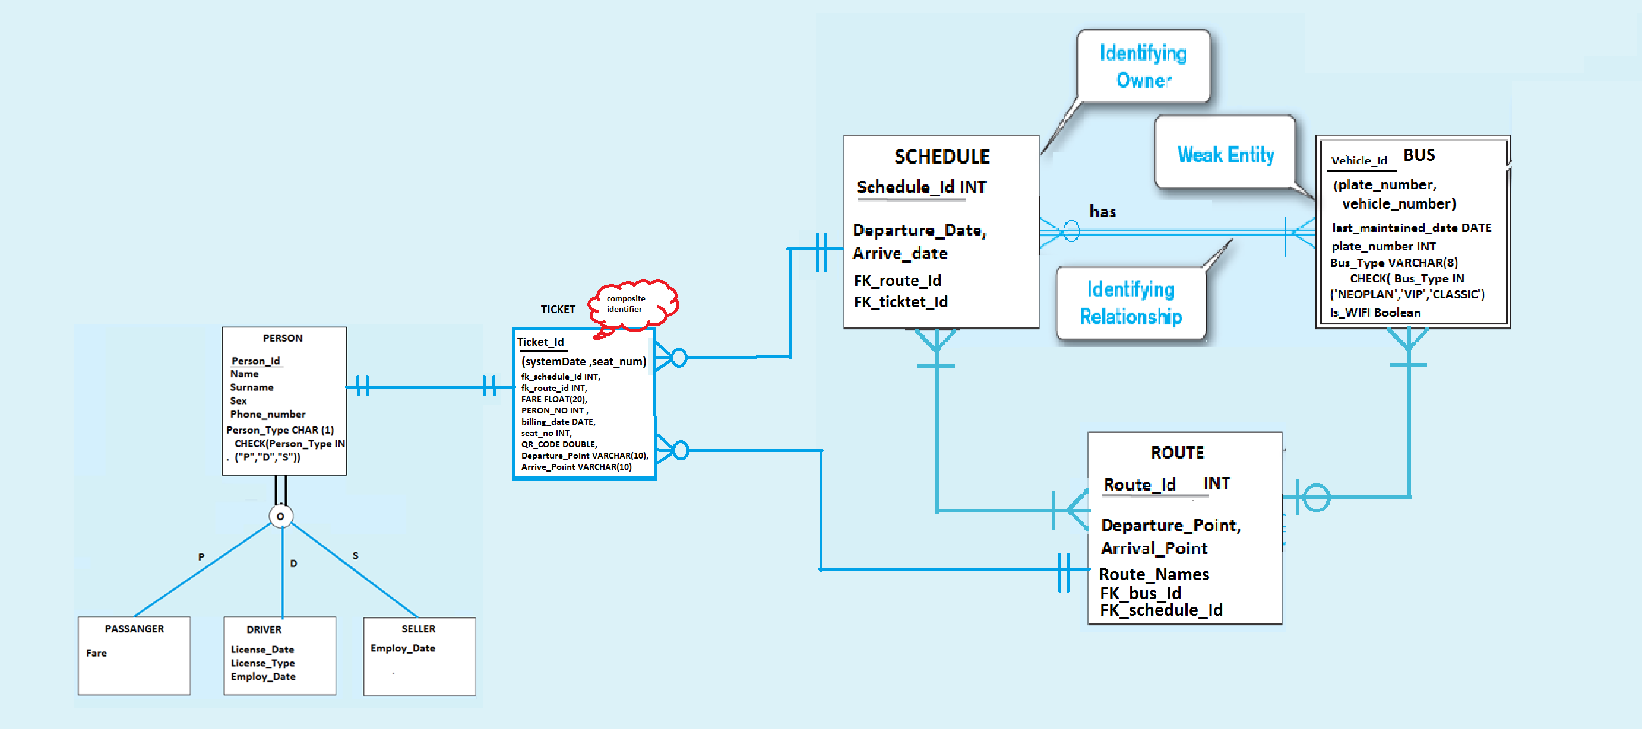

Slide 13
LOGIC DIAGRAM

Slide 14
