Slide 1

Doctor Patient Records
Slides by Sevilay Taha

Slide 2
Data Modeling

Slide 3
Stages of Data Modeling
Conceptual
Logical
Physical
Real Word
E-R Diagarm
Relational
Model
DBMS

Slide 4

The Work Rules
Each Medical Center or Patient or Doctor have one address.
In one addrress there may be one or medical center or doctor or patient.
A patient comes to medical center during first record he will asked about ID number and address.
A patient medical center is registered on the first visit to the doctor.
A patient can make many appointments with one or more doctors
A doctor can accept appointments with many patients.
However, each appointment is made with only one doctor, and each appointment references a single patient.

Slide 5
The Work Rules
Each visit will be either visit_medication or visit_procedure.
Every visit_medication assign to Mediction
Each visit_Medication will be out_visit medication or Resident_visit medication
Recident_visit_edication assign to Bed.
Every Visit_Procedure will assgin to procedure.
Every Visit_procedure will be out_visit_procedure or Resident_Visit_procedure.
Resident_Visit_procedure assgin to Bed.

Slide 6
The Work Rules
Each visit creates a bill. Each patient visit is billed by one doctor, and each doctor can bill many patients.
Each bill must be paid. However, a bill may be paid in many installments, and a payment may cover more than one bill.
A patient may pay the bill directly, or the bill may be the basis for a claim submitted to an insurance company.
If a bill is paid by an insurance company, the deductible is submitted to the patient for payment.

Slide 7
ER Diagram

Slide 8
Entity | Attributes
Doctor | Doctor_Id, Address_Id, patient_Id, Record_Id, Doc_Lname, Doc_Fname, cotact_Detailes, Medical_Center_Id
patients | Patient_Id, Patient_Lname, Patient_Fname, Gender, Date_Of_Birth, Date_Become_Patient, Insurance_Code
Medical Center | Medical_Center_Id, Address_Id
Visits | Visit_Id, Patient_Id, Address_Id, Doctor_Id, Visit_Date, Total_cost, Patiet_Id
Address | Address_Id, Address_Detailes, City_Code, Country_Code
Cities | City_Code, City_Name
countries | Country_Code, Country_Name
Insurance | Insurance_Code, Insurance_Type
Patient_Record | Patient_Record_Id, Update_Date, Component_Id, Patient_Id, Address_Id

Slide 9
Entity | Attributes
Visit_Medication | Visit_Id, Medication_Id, Doctor_Id, Patient_Record_Id, Address_Id
Visit_Procedure | Visit_Id, Medication_Procedure_Id, Doctor_Id, Patient_Record_Id, Address_Id
Out_Visit_Medication | Visit_Id, Medication_Id, Checkback_Date
Resident_Visit_Medication | Visit_Id, Medication_Id, discharged_Id
Medication | Medication_Id, Medication_Name, Medication_cost
Out_Visit_Procedure | Visit_Id, Medical_Procedure_Id, Checkback_Date
Resident_Visit_Procedure | Visit_Id, Medical_Procedure_Id, discharged_Id
Medical_Procedure | Medical_Procedure_Id, Medical_Procedure_Name, procedure_Cost
Bed | Bed_Id

Slide 10
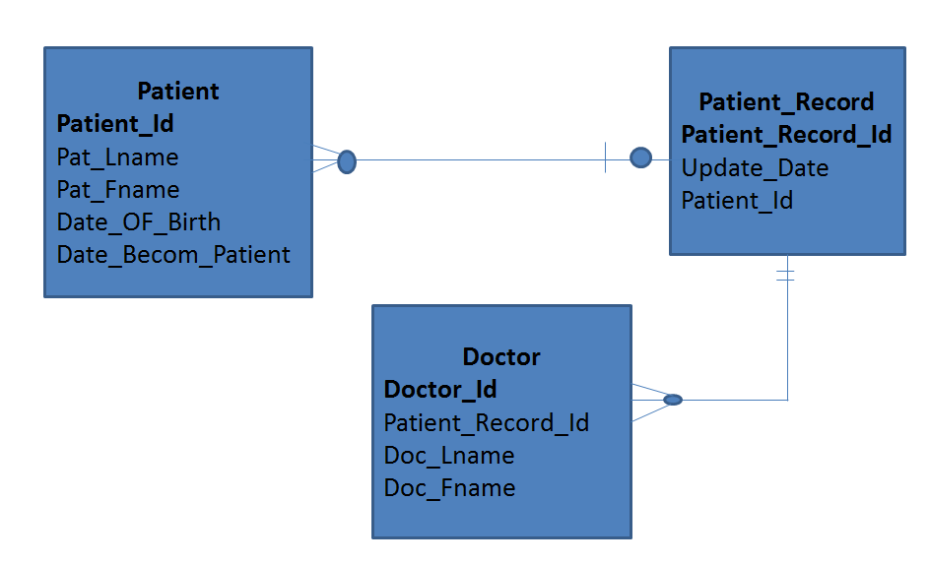

Slide 11
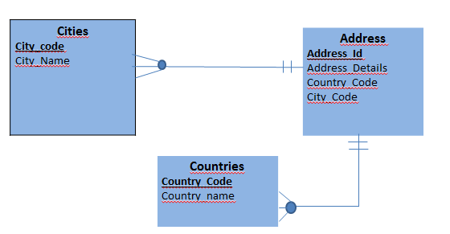

Slide 12
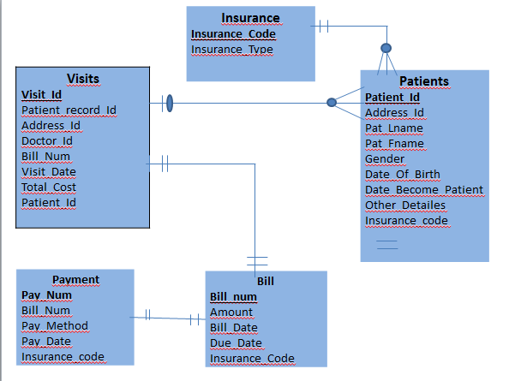

Slide 13
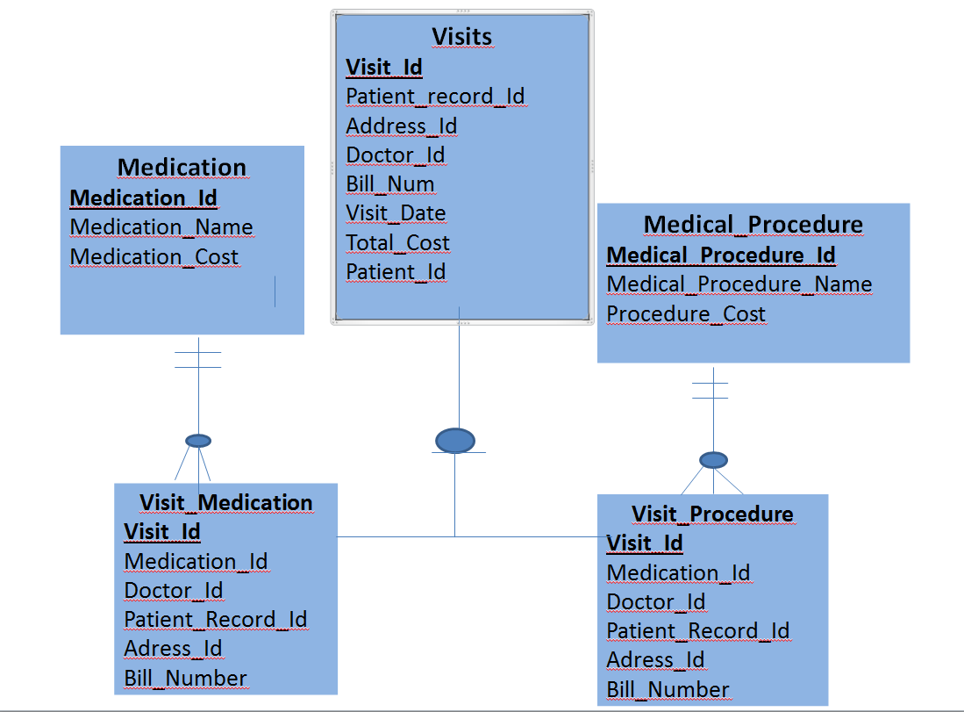

Slide 14
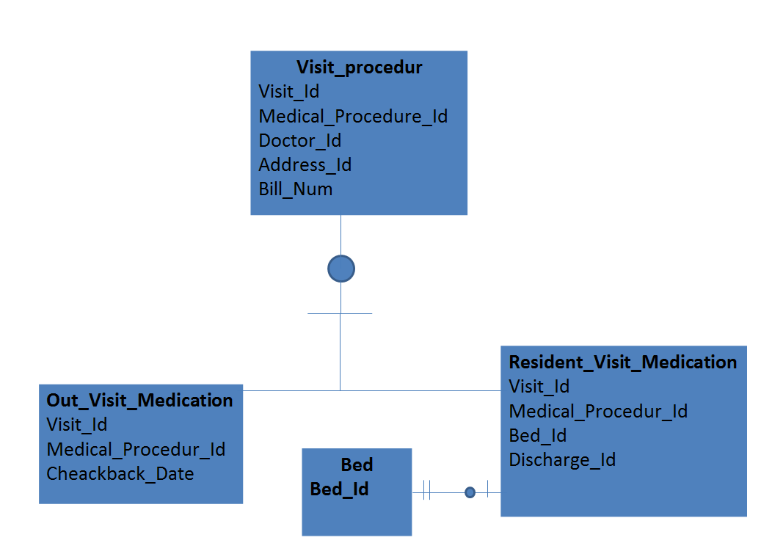

Slide 15
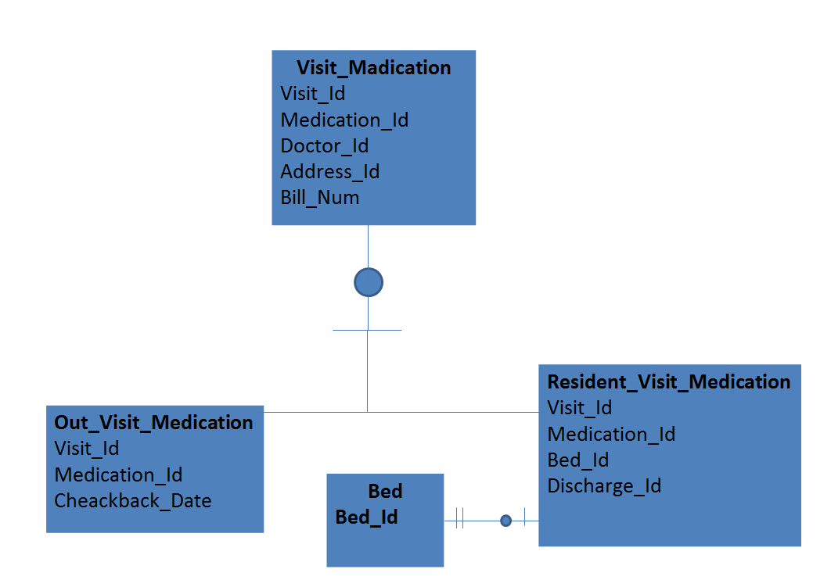

Slide 16
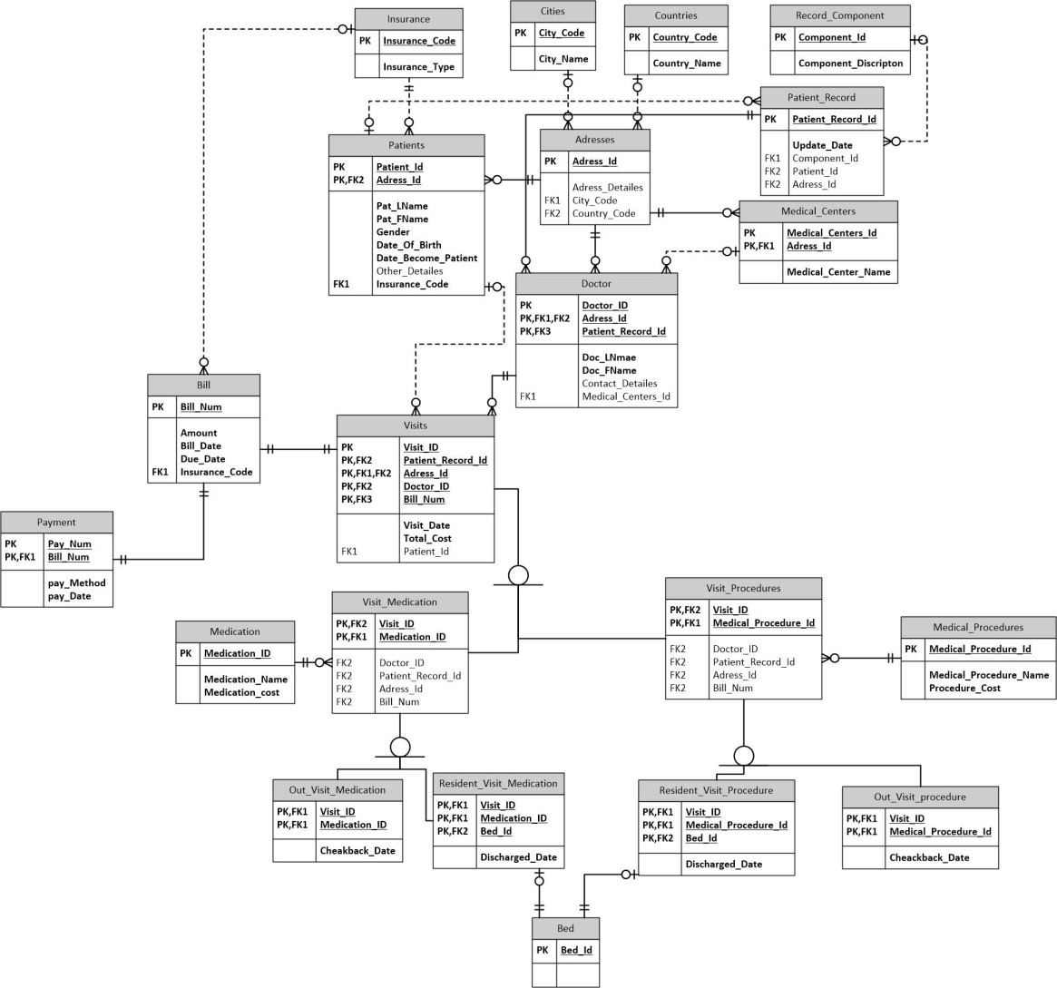

Slide 17

Logic Diagram

Slide 18
Primary Key Defination
Relation | Primary Keys
Medical_Center | Medical_Center_Id
Patient_Record | Patient_Record_Id
Record_Component | Record_component_Id
Address | Address_Id
Countries | Country_Id
Cities | City_Id
Patient | Patient_Id
Doctor | Doctor_Id

Slide 19
Primary Key Defination
Relations | Primary keys
Visits | Visit_Id
Insurance | Insurance_Id
Bill | Bill_Num
Payment | Payment_Num
Medication | Medication_Id
Medical_Procedure | Medical_Procedure_Id
Bed | Bed_Id

Slide 20
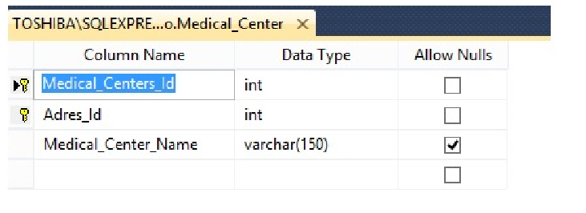
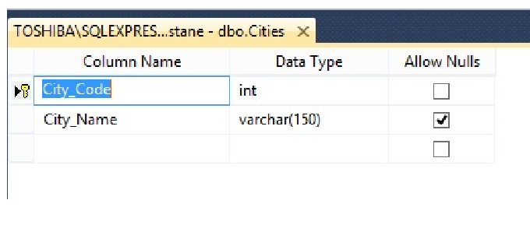
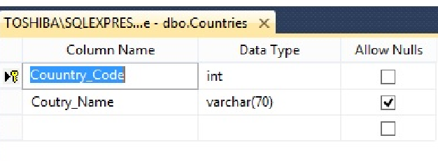

Slide 21
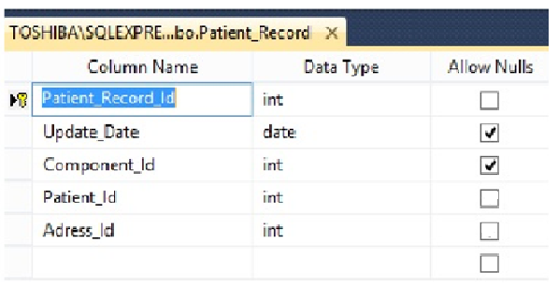
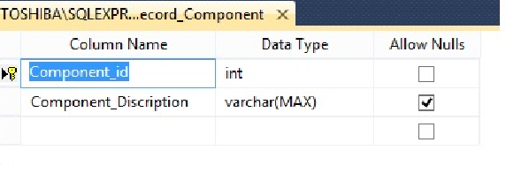
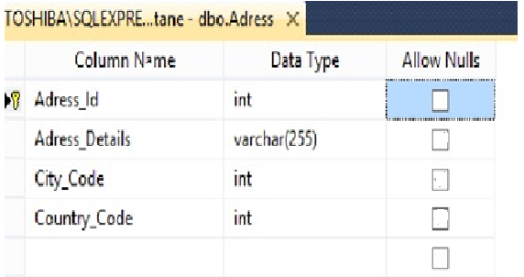

Slide 22
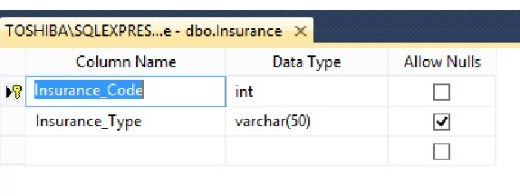
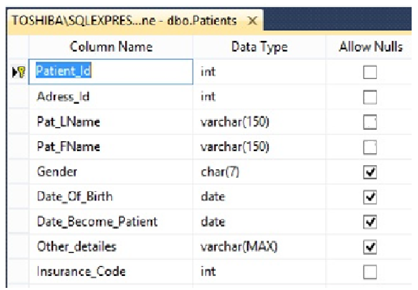

Slide 23
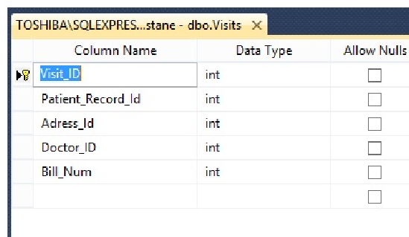
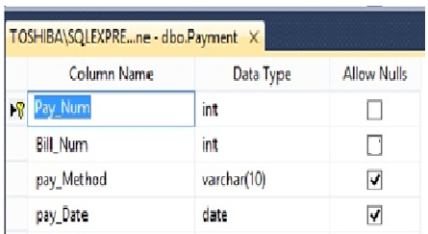
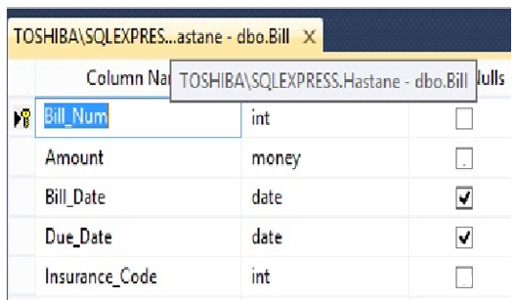

Slide 24
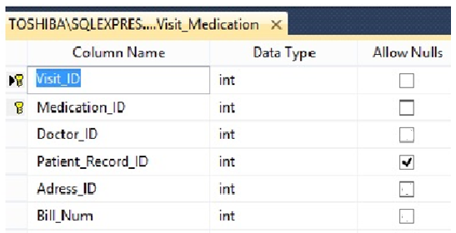
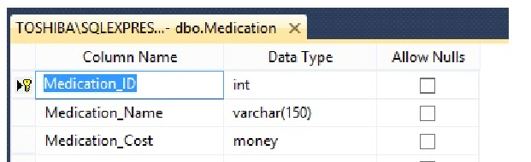
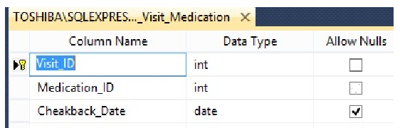

Slide 25
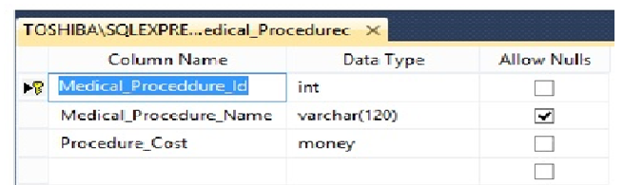
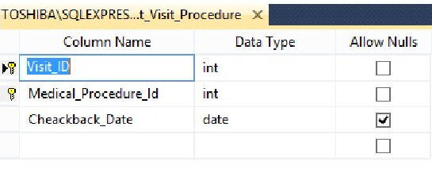
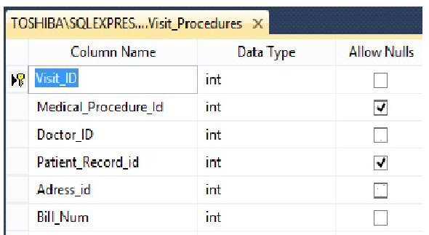

Slide 26
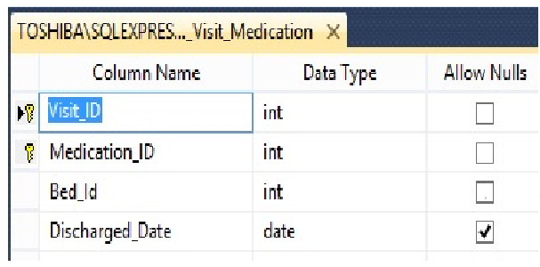
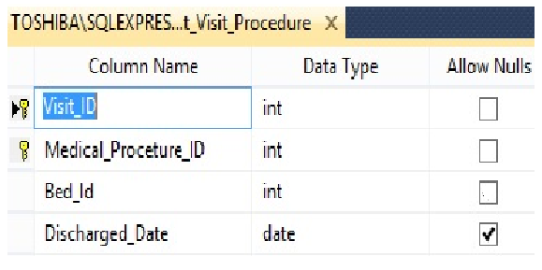
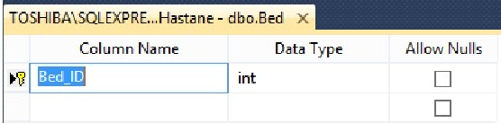

Slide 27
Thank You

