Slide 1
Kemal Tolun
Real Estate Agency Database
Advanced Database Systems – Prof. Dr. Hasan H. BALIK

Slide 2
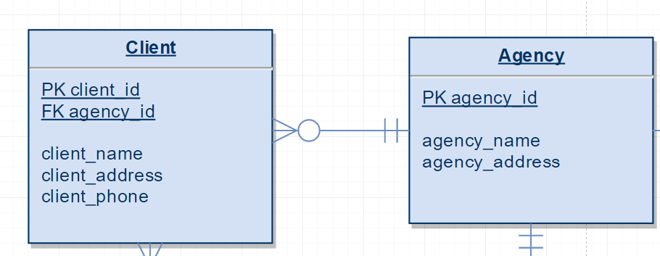
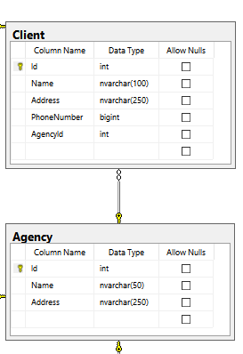
Business Rules
1) A client has one and only one agency.
2) An agency can have zero or many clients.
E-R Representation
Business Logic Representation

Slide 3
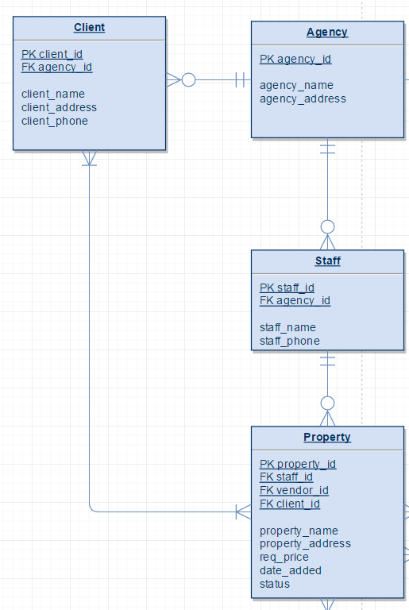
Business Rules
3) A client should enquire for or buy one or many properties.
E-R Representation
Business Logic Representation

Slide 4
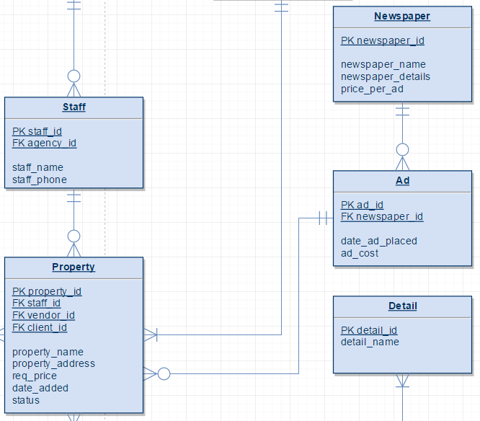
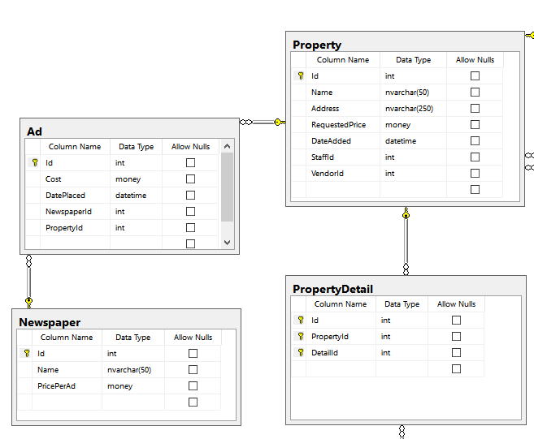
Business Rules
4) Zero or many advertisements can be placed in a newspaper.
5) A newspaper ad can be put for zero or many properties.
E-R Representation
Business Logic Representation

Slide 5
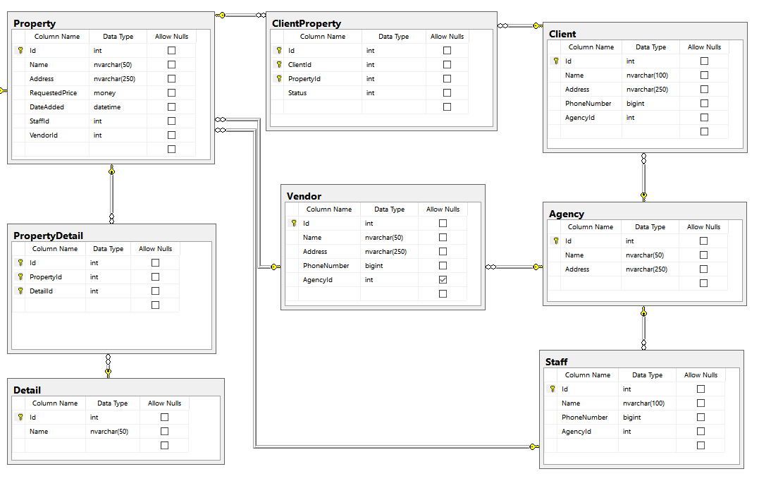
Business Rules
6) Each staff works for one and only one agency.
7) Each staff handles zero or many properties.
E-R Representation
Business Logic Representation

Slide 6
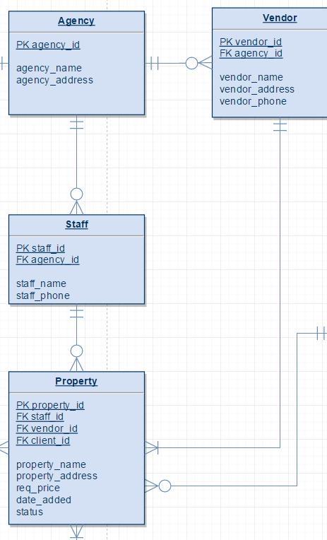
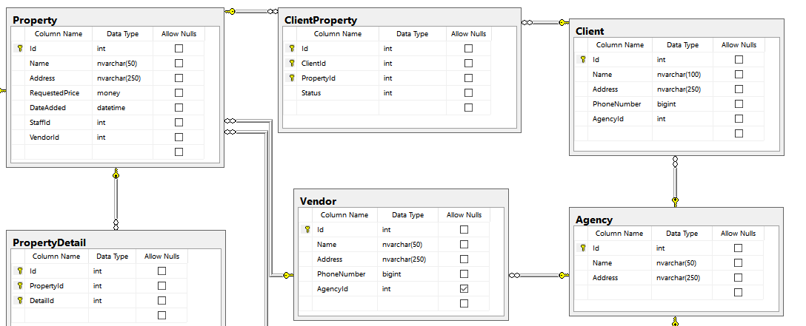
Business Rules
8) A vendor has one and only one agency.
9) A vendor should sell one or many properties.
10) An agency can work for zero or many properties.
E-R Representation
Business Logic Representation

Slide 7
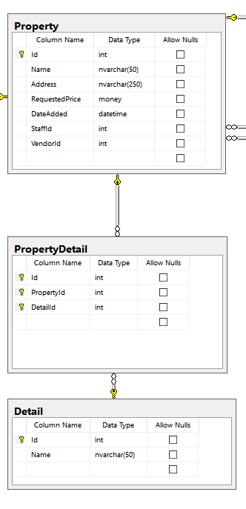
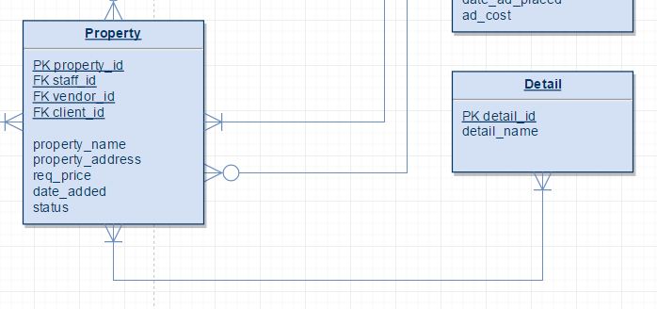
Business Rules
11) A property shouldhave one or more details.
12) A detail can be bound to one or more properties.
Business Logic Representation
E-R Representation

Slide 8
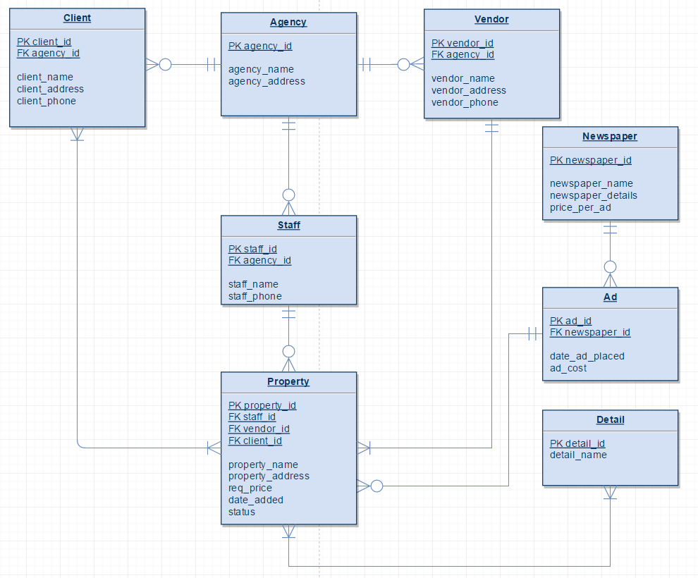
Full E-R Diagram

Slide 9
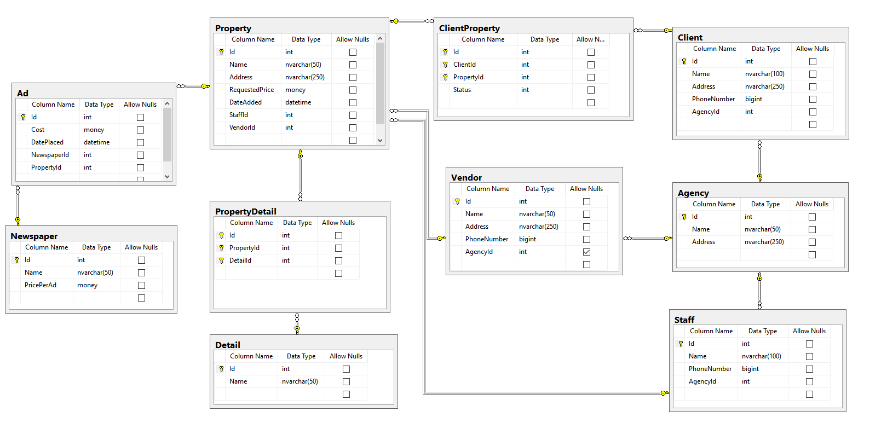
Logic Database Design

Slide 10
Real Estate Agency Database
Thank you!
Kemal TOLUN

